Slide 1
Snake Vs Blocks
Gandharv Mohan(2017232)
Anshuman Singh(2017025)

Slide 2
Features
The game is endless and only ends when the snake of the player dies.
The game can be paused and resumed as per the convenience of the player. It can also be reloaded after closing the window.
It has three four types of tokens that make the game more fun to play.
The game has a specialised loading screen before the game begins.
Speed of the snake in forward direction increases as its length increases.
The snake has to completely eat a block to pass it.
Snake cannot pass through a wall which appear randomly and are of different lengths.
Points of the player are calculated based on the number of blocks that the snake was able to eat.

Slide 3
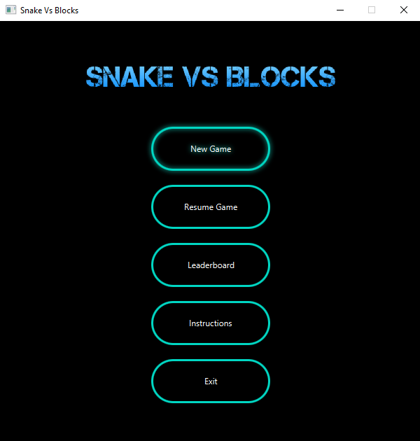
Design and Implementation
Used javafx for the animations and graphics
Used AnimationTimer for the movement of various components on the screen.
Used fxml files with java to make the loading screen.
Used css for changing the look of the buttons in the game.

Slide 4
Team Effort
Both contributed equally to this project till Deadline 2(UML diagrams and Static-GUI).
Most of the work for Deadline 3(Movement of various components and the backend implementation of the game) was done by Gandharv.

Slide 5
Bonus
Specialised Loading Screen
The screen is not resizable to make the game fair for everyone.

